Slide 1
✅ PHASE VII: Advanced Database Programming and Auditing
📌 Objective
Enhance automation, restrict critical operations on specific days, and implement user action tracking.
📄 Work Done
Created restriction triggers on donations
Prevent INSERT/UPDATE/DELETE on weekdays and holidays
Created auditing triggers for logging user actions
Built holiday_calendar reference table
Designed donation_audit table

Slide 2
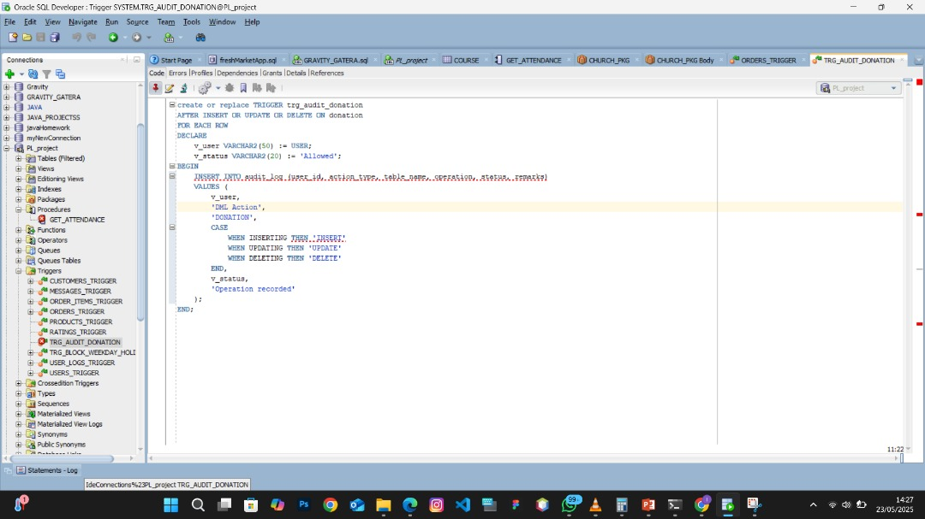

Slide 3
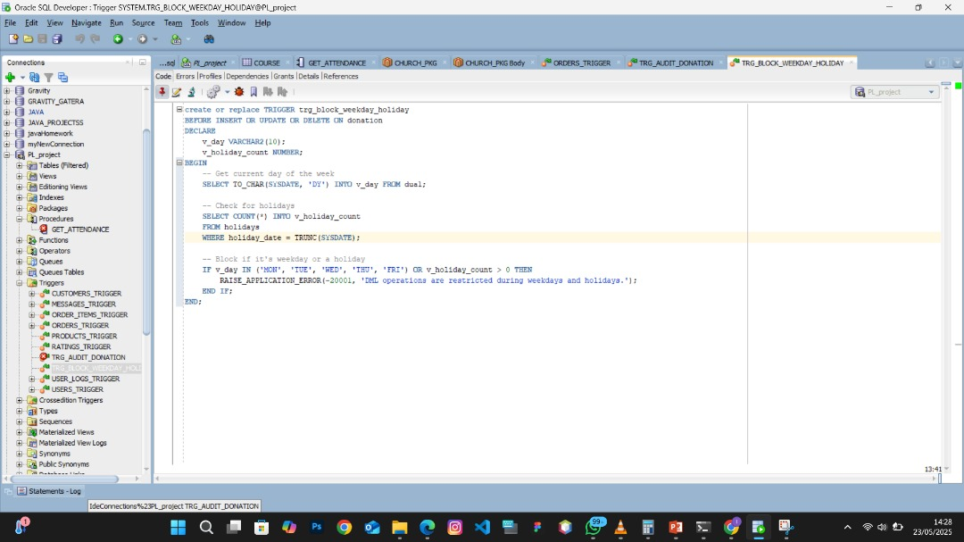

Slide 4
